Slide 1
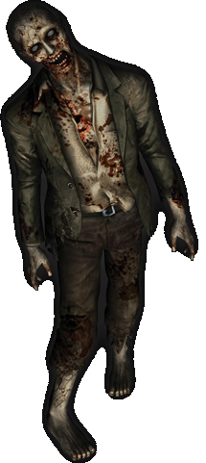
ZOMBIE MADNESS!
Jack Smith
Steve Mander-Jones
OUTLINE > GAME OVERVIEW > IMPLEMENTATION > AI FEATURES > CONCLUSION

Slide 2
PROJECT GOAL
Our goal with this project was to put into practice the different AI techniques we’ve learned, in a cohesive and sensible manner.
While we thought it was important to have a game that played well, we were also aware of the fact that AI comes first in this project.
OUTLINE > GAME OVERVIEW > IMPLEMENTATION > AI FEATURES > CONCLUSION

Slide 3
GOALS
The goal of the game, in it’s simplest form, is to escape the zombies by reaching the helipad. However, there’s distractions along the way!
Zombies
Roadblocks
Player inability (not enough health/fuel)
OUTLINE > GAME OVERVIEW > IMPLEMENTATION > AI FEATURES > CONCLUSION

Slide 4
GAME MECHANICS - Players
Players have the following attributes:
Health
Chainsaw Fuel
If a player has enough fuel, they can slice through a zombie pack. However, if they don’t, they’ll lose health (and probably get eaten).
OUTLINE > GAME OVERVIEW > IMPLEMENTATION > AI FEATURES > CONCLUSION

Slide 5
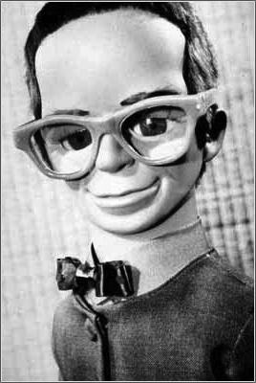
GAME MECHANICS - Zombies
Zombies are a simple bunch, they only really care about brains.
Zombies react to situations depending on their fellow zombies actions. If a zombie sees another running, it’ll assume it’s got brains and follow it.
OUTLINE > GAME OVERVIEW > IMPLEMENTATION > AI FEATURES > CONCLUSION

Slide 6
GAME MECHANICS - Pickups
The player can find items that may be of use to them in their escape. These items are:
Health packs
Fuel canisters
The health packs renew the players health, while the fuel can be used to increase the potency of the chainsaw.
OUTLINE > GAME OVERVIEW > IMPLEMENTATION > AI FEATURES > CONCLUSION

Slide 7
GAME CONCESSIONS - Simulation
We recognised early in the project that zombies aren’t the smartest of opponents. As such we deemed it necessary to provide a ‘simulation mode’ to our game.
In simulation mode, the player is replaced by computer AI, to demonstrate our implementation of AI principles.
OUTLINE > GAME OVERVIEW > IMPLEMENTATION > AI FEATURES > CONCLUSION

Slide 8
GAMEPLAY – AI Requirements
Must be able to use a pathfinding algorithm to traverse the tile based map.
Must use an influence map to find areas of zombie concentration (Simulation mode only).
Must use goal-oriented behaviour to determine actions.
  Player – Get fuel? Get health? Escape?
  Zombie – Wander? Follow for brains?
OUTLINE > GAME OVERVIEW > IMPLEMENTATION > AI FEATURES > CONCLUSION

Slide 9
TILES
We decided that a tile based 2D map was the easiest way to implement our environment.
The map is generated by a text file with a 2D grid of numbers, e.g.
A ‘W’ represents a game waypoint (used for pathfinding), a 0 represents a road (traversable) and a 1 represents a building (blocked).
W,0,0,0,0,W,0,0,0,0,W,0,0,0,0,0,0,0,0,W,
0,1,1,1,1,0,1,1,1,1,0,1,1,1,1,1,1,1,1,0,
0,1,1,1,1,0,1,1,1,1,0,1,1,1,1,1,1,1,1,0,
…
OUTLINE > GAME OVERVIEW > IMPLEMENTATION > AI FEATURES > CONCLUSION

Slide 10
TILES CONTINUED
This map file is then transformed into a 2D array, where each tile is represented by a Tile object.
This means we can traverse the array and find any tile based on a co-ordinate system.
Waypoints are also saved in a separate table.
OUTLINE > GAME OVERVIEW > IMPLEMENTATION > AI FEATURES > CONCLUSION

Slide 11

USER INTERFACE
OUTLINE > GAME OVERVIEW > IMPLEMENTATION > AI FEATURES > CONCLUSION

Slide 12
USER INTERFACE CONTINUED
We chose to use PyGame to develop our game, as we liked the flexibility it offered when it came to placing sprites on screen.
It made it easier to assign each tile a specific graphic and easily change the players and zombie sprite locations.
OUTLINE > GAME OVERVIEW > IMPLEMENTATION > AI FEATURES > CONCLUSION

Slide 13
PATHFINDING – Dijkstra
With our waypoint system we are able to find the shortest path from one waypoint to any other on the map.
We chose to implement Dijkstra’s algorithm as we needed a path where cost (tiles traversed) was a factor, and didn’t need the extra features of A*.
OUTLINE > GAME OVERVIEW > IMPLEMENTATION > AI FEATURES > CONCLUSION

Slide 14
TACTICAL AI – Influence Maps
Each zombie on the map has a pre-defined level of influence. This influence effects the tile it’s based on, and the tiles in an area around it.
The concentration of zombies in one area increases the influence across the areas tiles, and as such turns up as a blob.
OUTLINE > GAME OVERVIEW > IMPLEMENTATION > AI FEATURES > CONCLUSION

Slide 15
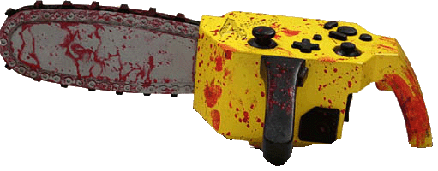
TACTICAL AI – Influence Maps
The influence map is then used by the simulation mode AI to determine if they can safely traverse that path.
They compare the fuel they have to the zombie influence in an area. If it passes a test, then they can carve their way through that path and continue on to freedom.
OUTLINE > GAME OVERVIEW > IMPLEMENTATION > AI FEATURES > CONCLUSION

Slide 16
TACTICAL AI – Decision Making
The simulation player AI is based on a decision making model.
If they need more fuel to get through a chosen path, they’ll go find it. If they need to get more health, they’ll search for a health pack.
This allows them to adapt to random zombie movement and encounters.
OUTLINE > GAME OVERVIEW > IMPLEMENTATION > AI FEATURES > CONCLUSION

Slide 17
ZOMBIE AI
The ‘simple’ behaviour of your traditional zombie is implemented in our game by a simple finite state machine.
If the zombie can’t see a human, and can’t see any other zombie running after brains, then they’ll just wander around until something happens.
OUTLINE > GAME OVERVIEW > IMPLEMENTATION > AI FEATURES > CONCLUSION

Slide 18
MISSING FEATURES
Zombie overlord
Vehicles
More weapons
Interactive buildings
OUTLINE > GAME OVERVIEW > IMPLEMENTATION > AI FEATURES > CONCLUSION

Slide 19
WHAT WE’VE LEARNT
That Dijkstra was one smart guy.
Zombies aren’t the best models for smart AI.
Great AI doesn’t make great gameplay (or any at all).
OUTLINE > GAME OVERVIEW > IMPLEMENTATION > AI FEATURES > CONCLUSION

Slide 20
REFERENCES/CREDITS
Zombies! Board game by Twilight Creations
www.pygame.org tutorials
www.python.org help files/wiki
Zombie/chainsaw image from Resident Evil
Brains appears courtesy of Thunderbirds

